Slide 1
Reinforcement Learning
Mica Haney, Bailu Zhang,
Poli Nemkova
Notes:
Poli
Hello everyone! We are group 26: Mica, Bailu, and me, Poli. We will present the introduction to Reinforcement Learning.

Slide 2
Self-driving cars
Industrial automation
Trading and finance
Gaming
In NLP
Real-time bidding
Robotics
Healthcare
Source: https://neptune.ai/blog/reinforcement-learning-applications
How ‘big’ is RL?
Notes:
Poli
First of all, let’s see why this topic is important.
Autonomous driving: in self-driving cars, there are various aspects to consider, such as speed limits at various places, drivable zones, avoiding collisions — just to mention a few. Some of the autonomous driving tasks where reinforcement learning could be applied include trajectory optimization, motion planning, dynamic pathing, controller optimization, and scenario-based learning policies for highways. For example, parking can be achieved by learning automatic parking policies.
Industrial: Apart from the fact that these robots are more efficient than human beings, they can also perform tasks that would be dangerous for people.
Finance: Supervised time series models can be used for predicting future sales as well as predicting stock prices. However, these models don’t determine the action to take at a particular stock price. Enter Reinforcement Learning (RL). An RL agent can decide on such a task; whether to hold, buy, or sell.

Slide 3
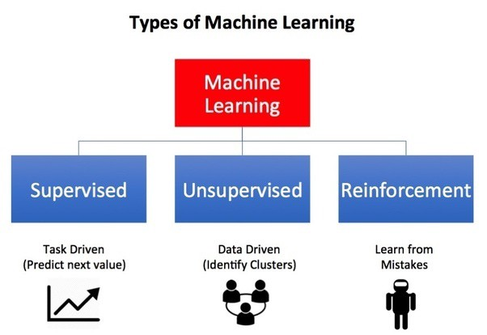
Reinforcement Learning:
Overview
What is Reinforcement Learning ?
Reinforcement Learning is a learning by trials and errors.
Reinforcement learning (RL) is one of the three archetypes of machine learning, the other two being supervised and unsupervised learning.
Reinforcement Learning (RL) is a type of machine learning technique that enables an agent to learn in an interactive environment by trial and error using feedback from its own actions and experiences.
Source: https://medium.com/analytics-vidhya/deep-multi-agent-reinforcement-learning-with-tensorflow-agents-1d4a91734d1f
Source: https://medium.com/analytics-vidhya/deep-multi-agent-reinforcement-learning-with-tensorflow-agents-1d4a91734d1f
Notes:
Poli:
There are multiple ways to define Reinforcement Learning. First of all, RL is a learning on mistakes. It is very similar to how we, humans, learn on the very early stage (or even later in some cases :) ).
Now, when we follow this principle computationally, we are talking about a machine learning technique. And this technique -- reinforcement learning -- is a separate category in ML alongside with supervised and unsupervised.
More specifically, RL uses agent which learn interacting with the environment by getting a feedback in a form of reward. The goal is to maximize the reward.

Slide 4
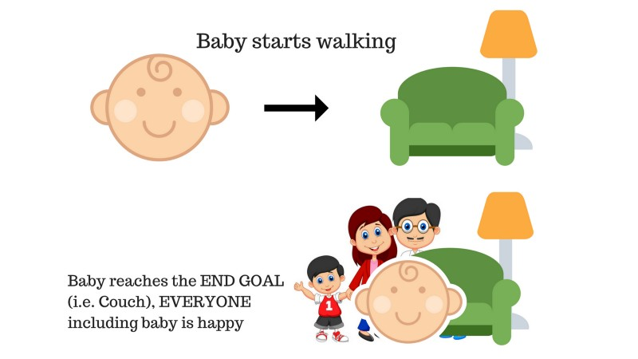
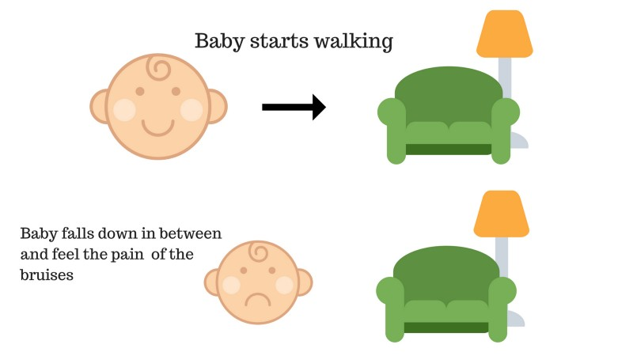
Case 1
Case 2
(Positive Reward +n)
(Negative Reward -n)
Notes:
Poli
The idea behind reinforcement learning is coming from the way human (and animal) are learning on the very early stage.
Case1: Baby starts walking and successfully reaches the couch:
the baby is happy and receives appreciation from her parents. It’s positive — the baby feels good (Positive Reward +n).
Case2: 2. Baby starts walking and falls due to some obstacle in between and gets hurt. The baby gets hurt and is in pain. It’s negative — the baby cries (Negative Reward -n).

Slide 5
RL key terminology
Environment — Physical world in which the agent operates
State — Current situation of the agent
Reward — Feedback from the environment
Policy — Method to map agent’s state to actions
Value — Future reward that an agent would receive by taking an action in a particular state
Notes:
Poli:
Environment: a room where the baby was learning to walk and parents.
State: Is baby happy or upset?
Reward: Did baby get hurt or they see parents smiling?
Policy: The more baby walk, the happier the parents.
Value: Parent will smile and praise the baby if they will walk over room.

Slide 6

Algorithmic Overview
RL models have two main components: an environment and an agent.
The environment is a Markov chain with a series of states and available actions at each state. Each action has a probability and/or reward attached to it.
The agent is a mathematical construct that uses multiple formulas to tune a policy formula that maximizes the expected cumulative award for completing the target task in the environment.
Notes:
Poli: The key concept behind RL: we have an environment which represents the outside world to the agent and an agent that takes actions. The environment is a Markov Decision Processes (MDP) that consists of a set of finite environment states S, a set of possible actions A(s) in each state, a real valued reward function R(s) and a transition model. The agent also receive observations from the environment that consists of a reward for their action and information of their new state. That reward informs the agent of how good or bad was the taken action, and the observation tells them what is his next state in the environment. The agent tries to figure out the the best actions to take or the optimal way to behave in the environment in order to carry out his task in the best possible way. The RL agent basically works on a hypothesis of reward maximization.

Slide 7
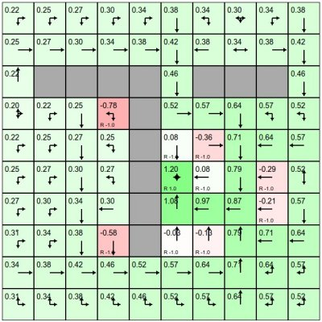
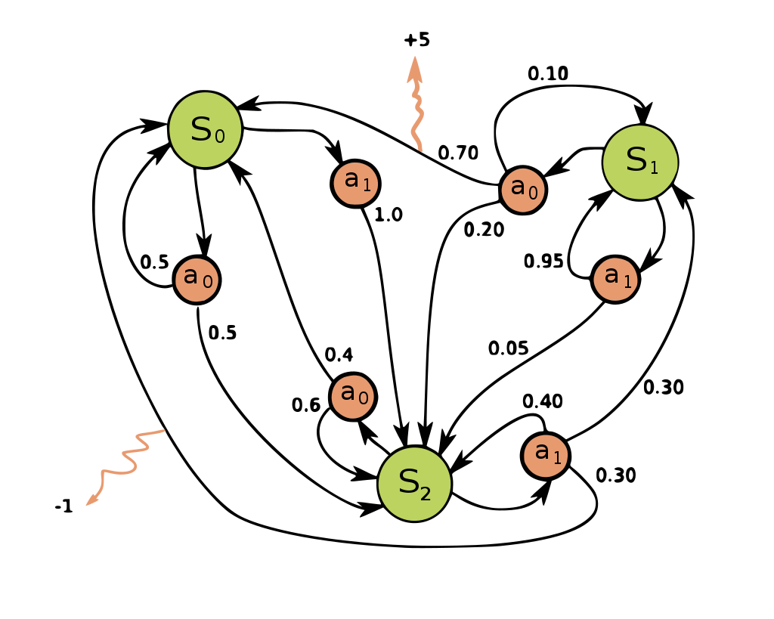
The Environment
The environment needs to be set up as a Markov decision chain. There must be a series of states, actions that can be taken at each state, and a reward (or punishment) for each selected action. Probabilities can also be attached to actions, to weight the likelihood of a specific action being taken or not.
Notes:
Mica

Slide 8
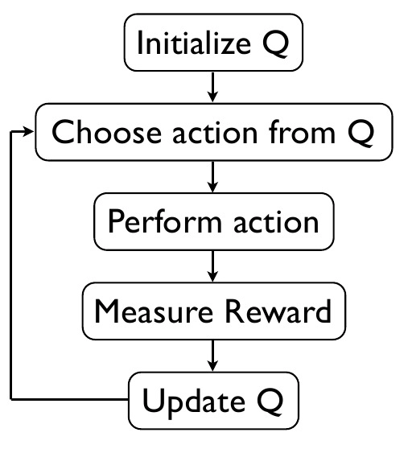
The Agent
The agent will take a given state in the environment and perform an action, and then update a policy formula based on the received award. The interesting thing about this is that the math for an agent is fairly independent from the environment. The formulas of an agent from one RL model will look similar or identical to the formulas for an agent of a different environment.
Notes:
Mica

Slide 9
Categorizing Reinforcement Learning Agents
Value-Based Agent, the agent will evaluate all the states in the state space, and the policy will be kind of implicit, i.e. the value function tells the agent how good is each action in a particular state and the agent will choose the best one.
Policy-Based Agent, instead of representing the value function inside the agent, we explicitly represent the policy. The agent searches for the optimal action-value function which in turn will enable it to act optimally.
Actor-Critic Agent, this agent is a value-based and policy-based agent. It’s an agent that stores both of the policy, and how much reward it is getting from each state.
Model-Based Agent, the agent tries to build a model of how the environment works, and then plan to get the best possible behavior.
Model-Free Agent, here the agent doesn’t try to understand the environment, i.e. it doesn’t try to build the dynamics. Instead, we go directly to the policy and/or value function. We just see experience and try to figure out a policy of how to behave optimally to get the most possible rewards.
Notes:
I added this slide, I thought it’s insightful (but we can remove, if Mica doesn’t want to include it to her logical portion) --Poli

Slide 10
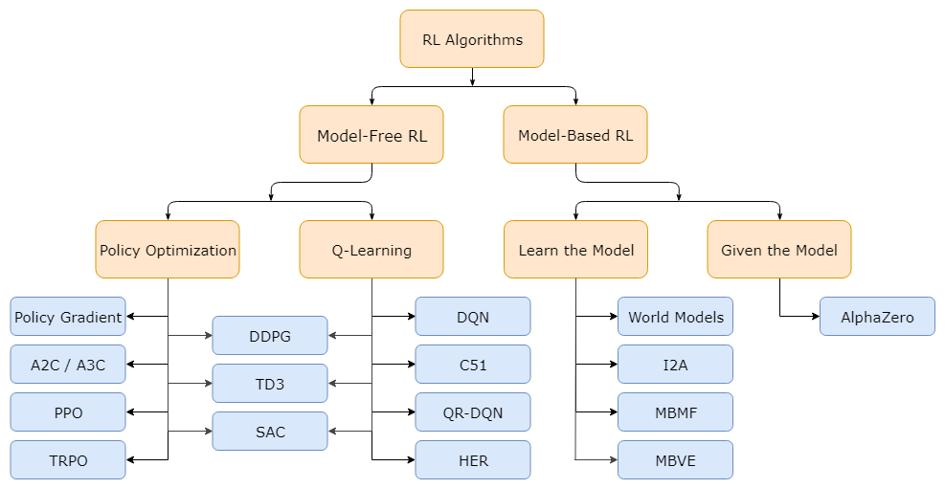
Kinds of Algorithms in RL
Source: https://spinningup.openai.com/en/latest/spinningup/rl_intro2.html
Notes:
Mica

Slide 11
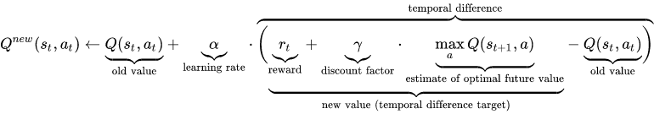
The Math
Q Function - Model Free Agent
The function used to explore state-action pairs is the Q Function. This function is totally independent of the environment, taking only the previous value and the reward for the chosen action as inputs. The Q-values are used to build a Q-table of states, actions, and Q values. As the agent explores the environment, the Q table is filled out.
Notes:
Bailu: Q LEARNING IS SPECIAL!

Slide 12
The Math
Value Function
This is a function that’s part of the agent that predicts an expected reward for an action. This is the main function that’s tuned during learning, as the goal is to correctly predict rewards for actions so as to select the best possible series of actions.
Notes:
Bailu:
Pi: policy function
s: state at time step t
y: discount factor, between (0,1), reduced the impact of future rewards in current state
https://becomesentient.com/reinforcement-learning-intro/

Slide 13
The Math
Policy Function
The policy function is not only a part of the agent, but a part that is dependent on the environment. This is used to determine which action for a given state the agent will choose.
The policy should be balanced between exploration - choosing a simple “this is best” action every time - and exploration - choosing as many unexplored actions as possible.
Notes:
Bailu: Based on various distribution patterns.

Slide 14
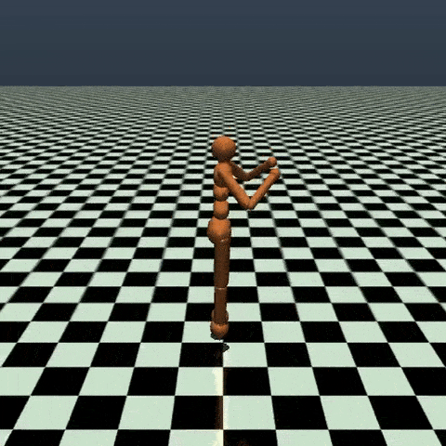
Successful Application
RL methods have recently enjoyed a wide variety of successes.
It’s also famously been used to create breakthrough AIs for sophisticated strategy games, most notably Go and Dota, taught computers to play Atari games from raw pixels, and trained simulated robots to follow human instructions.
Source: https://spinningup.openai.com/en/latest/spinningup/rl_intro.html
Notes:
Mica

Slide 15
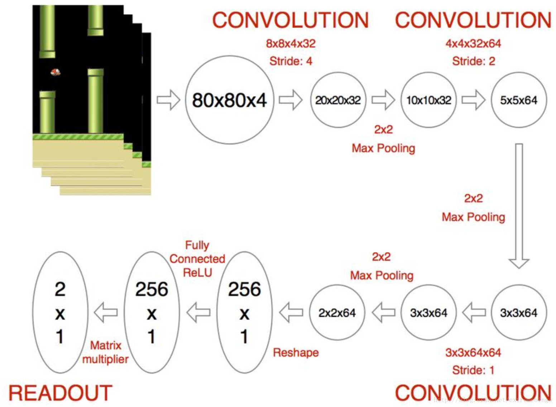
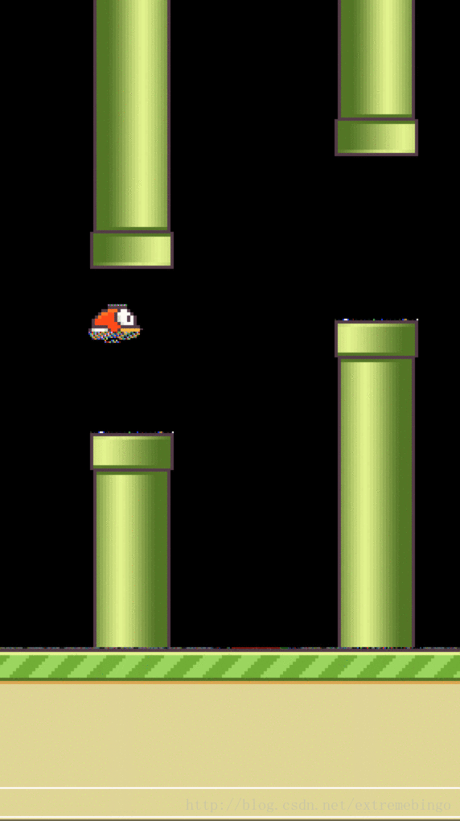
Deep Q-Network(DQN) playing flappy bird
Notes:
Bailu

Slide 16
Resources
https://towardsdatascience.com/reinforcement-learning-from-scratch-designing-and-solving-a-task-all-within-a-python-notebook-48c40021da4
https://artint.info/html/ArtInt_227.html
https://towardsdatascience.com/reinforcement-learning-with-python-part-1-creating-the-environment-dad6e0237d2d
https://en.wikipedia.org/wiki/Reinforcement_learning
https://www.analyticsvidhya.com/blog/2017/01/introduction-to-reinforcement-learning-implementation/
https://pythonprogramming.net/q-learning-reinforcement-learning-python-tutorial/
https://www.researchgate.net/figure/Reinforcement-Learning-Agent-and-Environment_fig2_323867253
https://en.wikipedia.org/wiki/Markov_decision_process
https://cs.stanford.edu/people/karpathy/reinforcejs/
https://en.wikipedia.org/wiki/Q-learning
https://www.tomshardware.com/news/alphago-defeats-sedol-second-time,31377.html

